Slide 1
Many Faces of the Intelligent Transportation
Mitja Jermol
CECIIS 2014, Varazdin

Slide 2
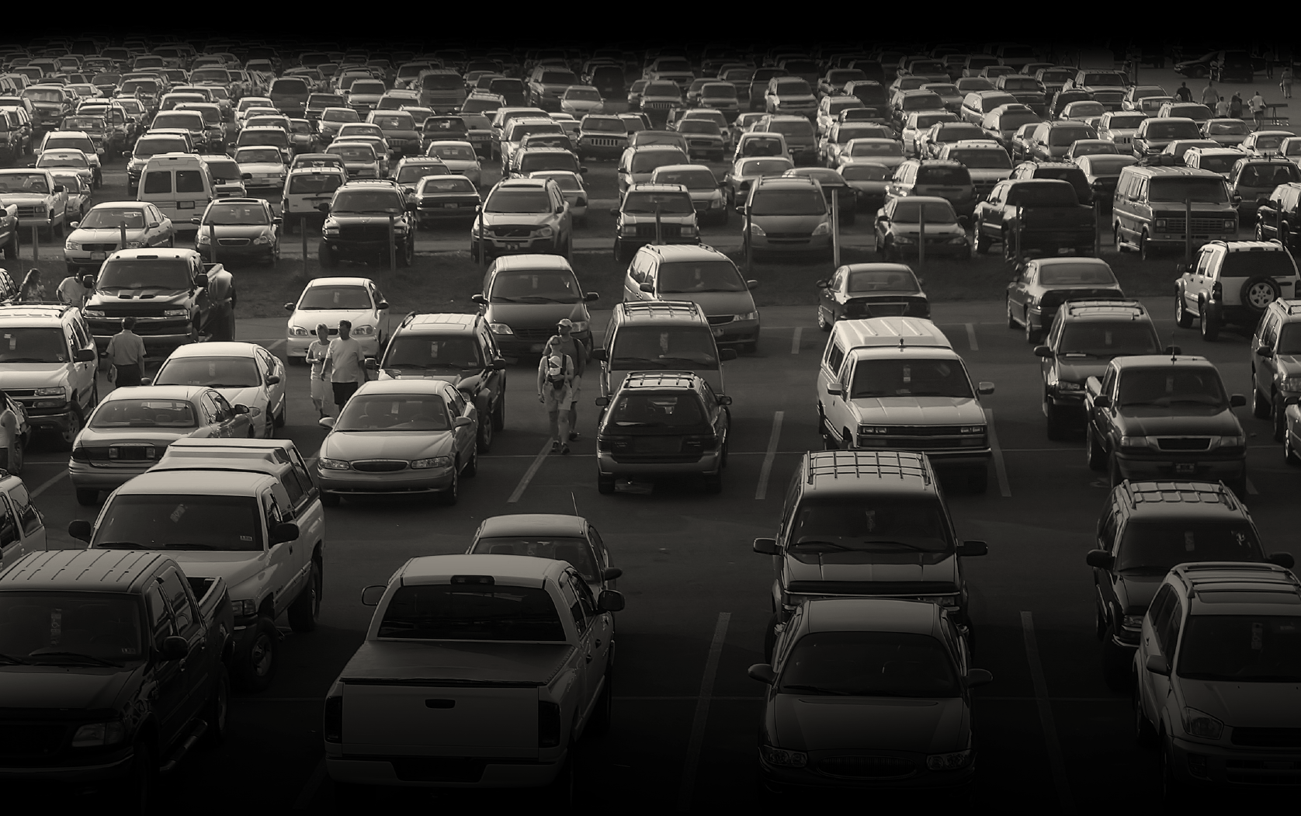

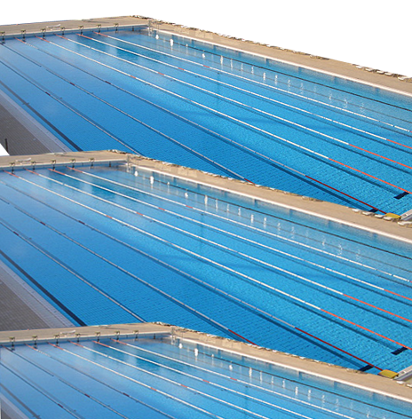
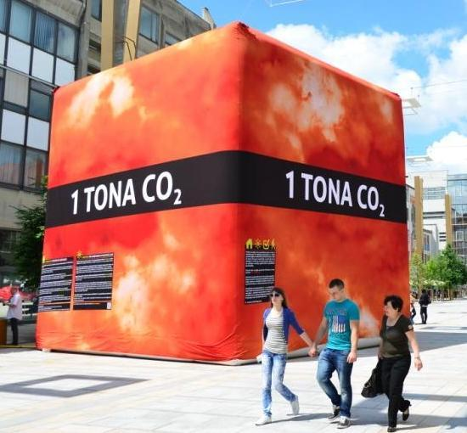
Illustrative example of parking in 15 blocks in Westwood (LA)
3-14 minutes
38 X
Around the Earth
2.3
Swimming pools of gas
730
Cubes of CO2
GLOBAL PROBLEM
(UCLA Professor Donald Shoup: LA study)

Slide 3
Transportation problems
CONGESTION: increasingly congested facilities across all modes;
EMERGENCIES: vulnerability to natural disasters, strikes;
ENERGY AND ENVIRONMENT: extraordinary challenges;
EQUITY: burdens on the disadvantaged;
FINANCE: inadequate revenues;
HUMAN AND INTELLECTUAL CAPITAL: inadequate investment in innovation;
INFRASTRUCTURE: enormous, aging capital stock to maintain;
INSTITUTIONS: 20th century institutions mismatched to 21st century missions;
SAFETY: lost leadership in road safety
How methods, techniques and solutions from a wide AI area are being implemented in intelligent transportation…
Lessons learned from past and existing RTD projects in the area
Potential future directions and current state of the art AI used in transportation
http://onlinepubs.trb.org/onlinepubs/general/CriticalIssues06.pdf

Slide 4



























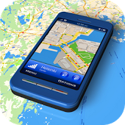






























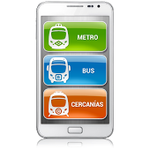















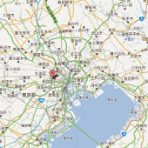











What is out there?
More than 300 apps on iTunes
More than 500 apps on Googleplay
More than 100 commercial systems

Slide 5
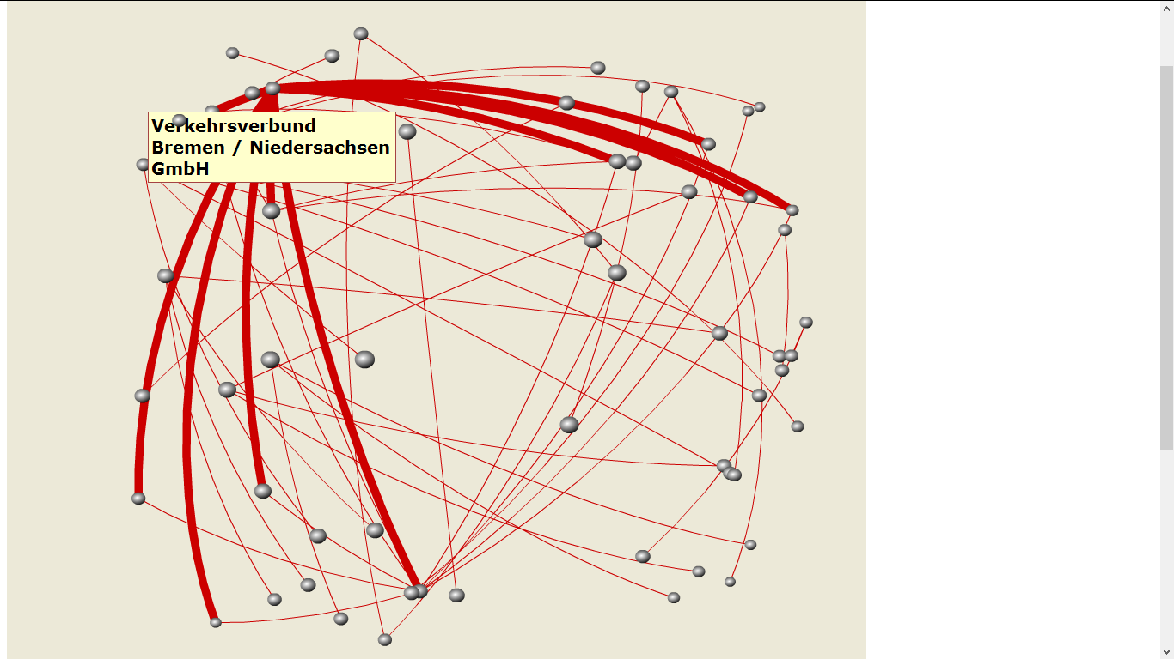
What EU has done?
Transportation Projects funded from FP5 – FP7 (>700) (http://ec.europa.eu/research/transport/)
Intelligent transport systems (>1000 projects) EU + national (http://www.transport-research.info/web/)
http://www.ist-world.org

Slide 6
What EU is doing?
Air
  Greening air transport
  Time efficiency
  Customer satisfaction and safety
  Cost efficiency
  Protecting aircraft and passengers
  Air transport in future
Rail
  Interoperability
  Intelligent mobility
  Safety and security
  Environment
  Innovative materials and production methods
Water
  Greener waterborne transport
  Safety and security
  Intermodality and logistics, including ports and inland waterways
  The Ocean of Tomorrow
Road
  Greener road transport
  Modal shift and decongestion of transport corridors
  Sustainable urban transport
  Safety and security
  Competitiveness
  Green cars initiative
  The Fuel Cells and Hydrogen Joint Technology Initiative
Multimodal
  Sustainable urban transport
  Intermodal freight transport
  Intelligent transport systems

Slide 7
What EU is doing?
H2020: Smart, Green and Integrated Transport
€6.339 million Euros
KW:
  resource efficient transport that respects the environment
  better mobility, less congestion, more safety and security
  global leadership for the European transport industry
  a socio-economic and behavioural research and forward looking activities for policy making
Mobility for Growth
Green Vehicles
Small Business and Fast Track Innovation for Transport

Slide 8
What is out there?
Large scale reasoning
Cognitive systems
Interoperability models and solutions
Language technologies
Self-awareness
Mass data
Semantic and Context
technologies
Multimodal data
Machine learning
Multilingual data
Information retrieval
Knowledge discovery
Multimodal interfaces
Some meta-information
Ubiquitous sensing
Data collection and storage
Internet of things (everything)

Slide 9
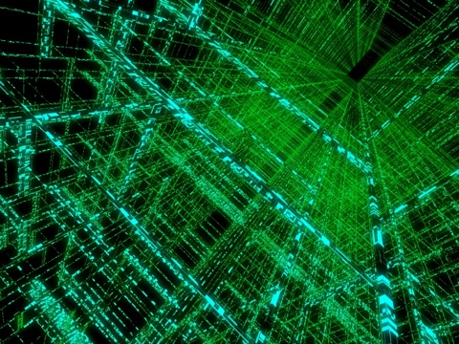
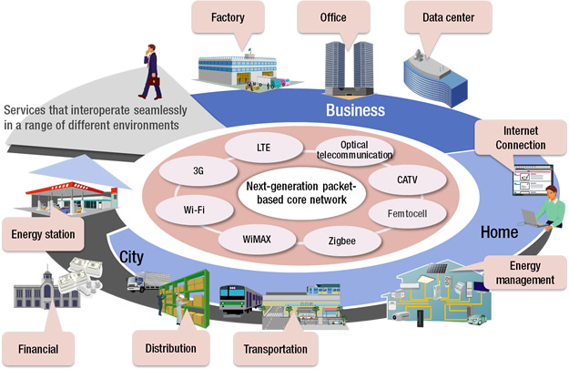
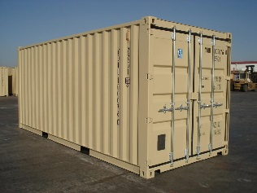
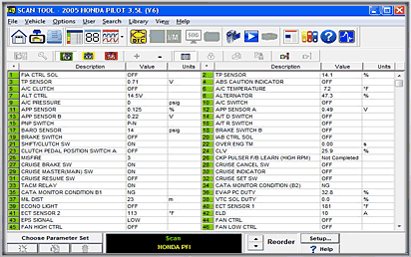

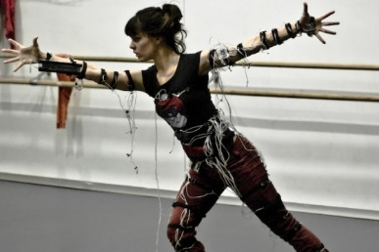
Mass data
> Zillion
>1.5 Billion
>7 Billion

Slide 10
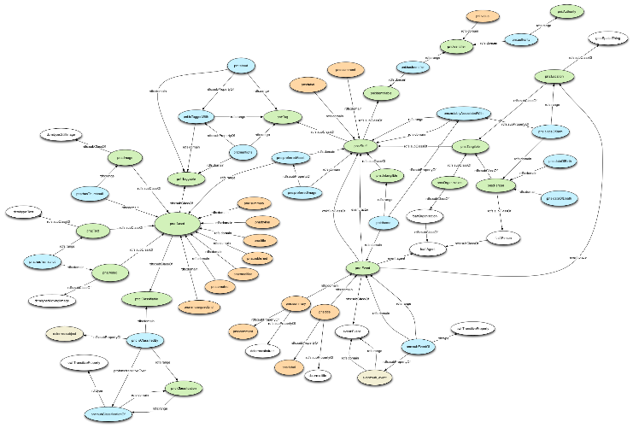
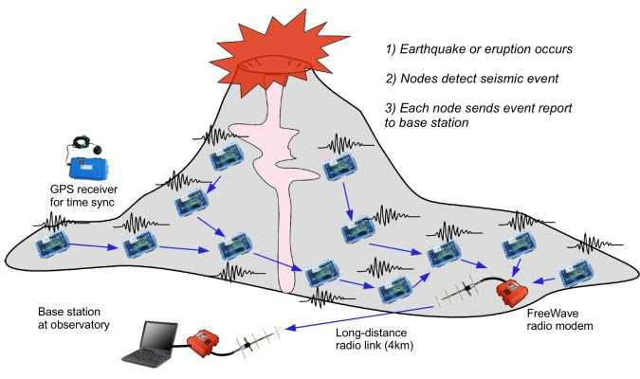
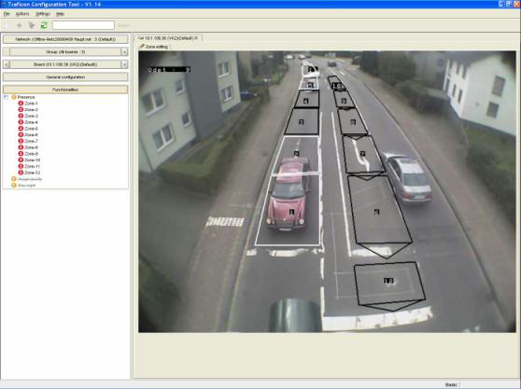
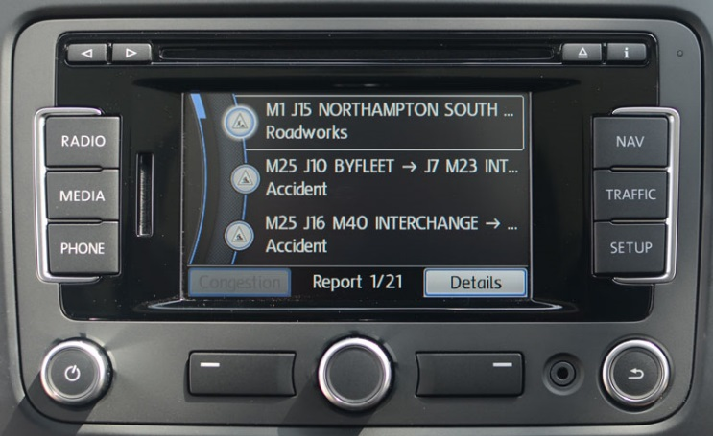
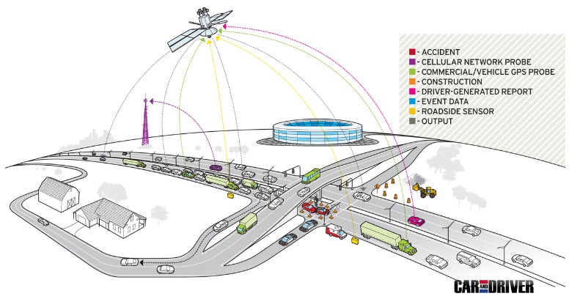
Multimodal form
Formalised knowledge
Sensor network data
Video data streams
Unstructured textual data
Structured data

Slide 11

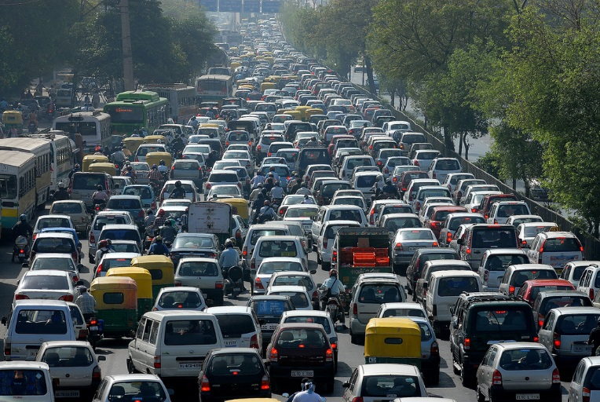
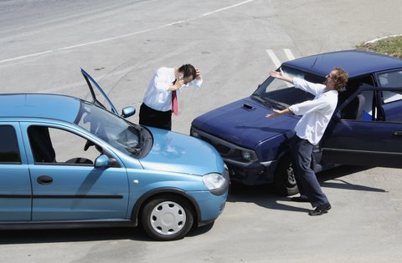
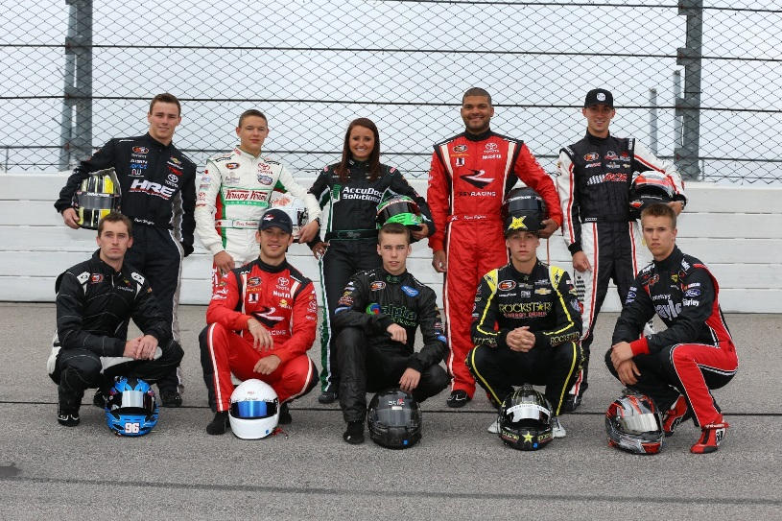

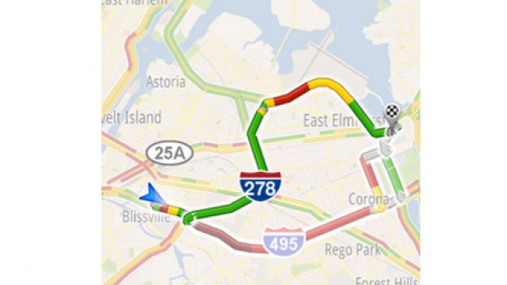
Real time response
Monitoring/anomaly detection
Reasoning and Acting
Assessing/behavior modeling
nearly real-time
Predicting
Planning and Rerouting
Classifying and dependency models

Slide 12
Motivation
Analysis of complex environment like transportation requires the analysis of vast amount of multimodal data in real-time.
A combination of data driven and knowledge driven techniques can support both the volume of analysis, and the detailed analysis that are needed.

Slide 13
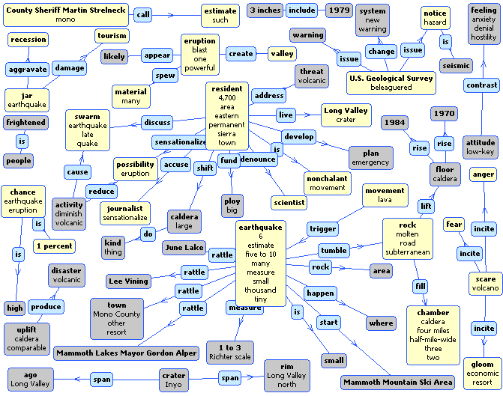
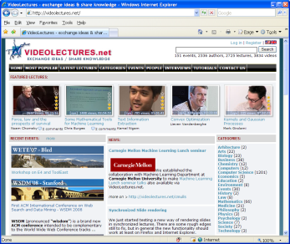
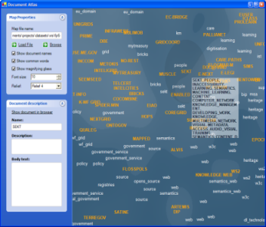
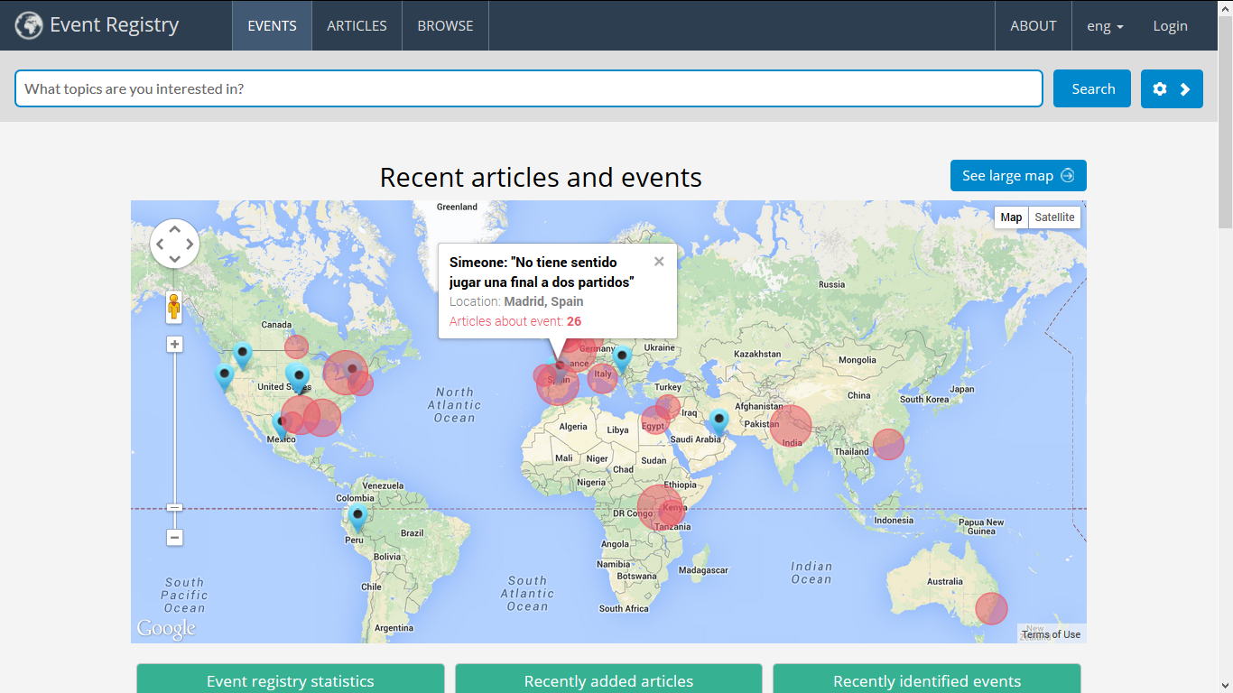

Jozef Stefan Institute
Artificial Intelligence Laboratory
Jozef Stefan Institute (JSI) is the leading Slovene research institution for natural sciences (900+ people) in the areas of computer science, physics, chemistry
Artificial Intelligence Laboratory has approx. 60 people working in various areas of artificial intelligence (machine learning, data mining, semantic technologies, computational linguistics, decision support)
Spinoff-s: Quintlligence, Cyc-Europe, LiveNetLife, BlueEye, Global Consequences
Academic Partners: Carnegie Mellon, Cornel, Stanford, MIT, Uni. Maryland, KIT, UCL, W3C
Business Clients: Accenture Labs, Bloomberg, British Telecom, Google Labs, Microsoft Research, New York Times, Siemens, Wikipedia
Selection of Portals and Products:
  Text-Garden (http://www.textmining.net)
  Enrycher (http://enrycher.ijs.si/)
  VideoLectures.NET (http://videolectures.net/)
  IST-World (http://www.ist-world.org/)
  Event registry (http://eventregistry.org)
  Search-Point (http://searchpoint.ijs.si/)
  OntoGen (http://ontogen.ijs.si/)
  Document-Atlas (http://docatlas.ijs.si/)
  Qminer (http://qminer.ijs.si)
Semantic-Graphs
VideoLectures.NET
Document-Atlas
Eventregistry
Selection of FP6 & FP7 Projects (Integrated Projects and Networks of Excellence only):
  FP7 IP ACTIVE – Enabling the Knowledge Powered Enterprise
  FP7 IP COIN – COllaboration and INteroperability for networked enterprises
  FP7 IP EURIDICE – Inter-Disciplinary Research on Intelligent Cargo for Efficient, Safe and Environment-friendly Logistics
  FP7 NoE PASCAL2 – Pattern Analysis, Statistical Modeling and Computational Learning
  FP7 NoE T4ME – Machine Translation & Multilingual Information Retrieval
  FP6 IP NeOn – Lifecycle Support for Networked Ontologies
  FP6 IP ECOLEAD – European Collaborative Networked Organizations Leadership Initiative
  FP6 IP SEKT – Semantically-Enabled Knowledge Technologies

Slide 14
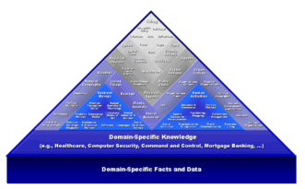
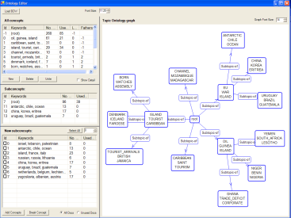
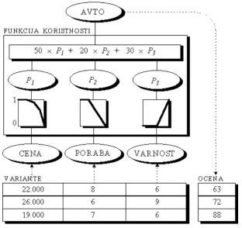
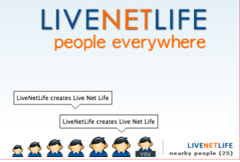

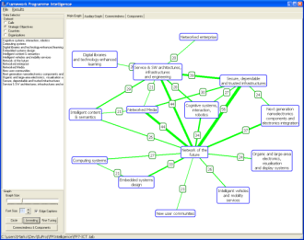
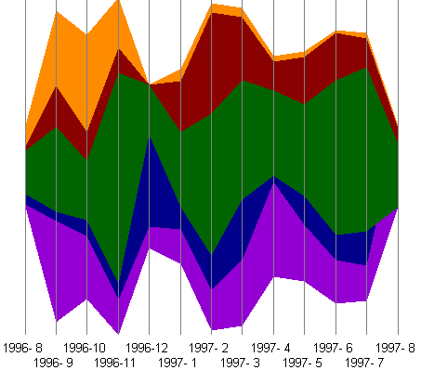
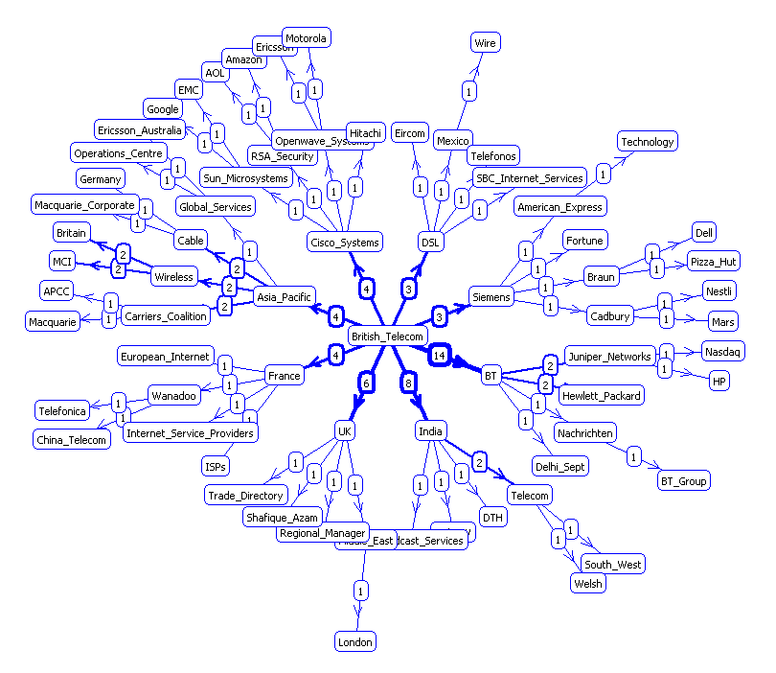
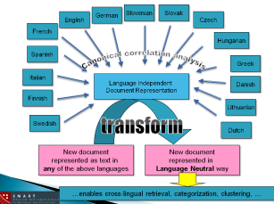
Core Technologies
Deep Semantics & Reasoning (Cyc)
Light-Weight Semantic Technologies
(OntoGen, OntoBridge)
Decision Support (DEX)
Social Computing/Web2.0 (LiveNetLife)
Computational Linguistics
(Enrycher, AnswerArt)
Complex Data Visualization
(DocAtlas, NewsExplorer, SearchPoint)
Graph/Social Network Analysis
(GraphGarden/SNAP, IST-World, FPIntelligence)
Data/Web/Text/Stream-Mining
(TextGarden Suite of tools)
Statistical Machine Learning

Slide 15
7OP (25)
FP7 STREP XLime: crossLingual crossMedia knowledge extraction (FP7-ICT-611346) (2013-2016)
FP7 STREP COMET: Complex Contextualization of Mobile Apps with Open Governmental Data (FP7-ICT-611655) (2013-2015)
FP7 STREP ProaSense: The Proactive Sensing Enterprise (FP7-ICT-612329) (2013-2016)
FP7 STREP SYMPHONY: Orchestrating Information Technologies and Global Systems Science for Policy Design and Regulation of a Resilient and Sustainable Global Economy (FP7-ICT-611875) (2013-2016)
FP7 SSA MEDIAMIXER: Community set-up and networking for the reMIXing of online MEDIA fragments (FP7-ICT-318101-CSA) (2012-2014)
FP7 STREP MOBIS: Personalized Mobility Services for energy efficiency and security through advanced Artificial Intelligence techniques (FP7-ICT-318452) (2012-2015)
FP7 STREP NRG4Cast: Energy Forecasting (FP7-ICT-600074) (2012-2015), FP7-STREP SOPHOCLES: Self-Organised information PrOcessing, CriticaLity and Emergence in multilevel Systems (FP7-317534-STREP) (2012-2015)
FP7 STREP TOPOSYS: Topological Complex Systems (FP7-ICT-318493-STREP) (2012-2015)
FP7 SSA LT-Web: Language Technologies in the Web (FP7-ICT-287815 -CSA) (2012-2014)
FP7 STREP Translectures: Transcription and Translation of Video Lectures (FP7-ICT-287755-STREP) (2011-2014)
FP7 STREP XLike: Cross Lingual Knowledge Extraction (FP7 -ICT-288342- STREP) (2012-2014)
FP7 SSA ESC FP7: European Security Challenge (2011-2012)
FP7 SA SiS CATALYST: Children as Change Agents for Science in Society (2011-2014)
FP7 STREP RENDER: Reflecting Knowledge Diversity (2010-2013) (ICT-257790-STREP)
FP7 STREP ALERT: Active Support and Real-time Coordination based on Event processing in FLOSS development (2010-2013) (ICT-249119-STREP)
FP7 NoE Planetdata: Intelligent Information Management (2010-2014) (ICT-257641-NoE)
FP7 NoE MultilingualWeb: Advancing the Multilingual Web (2010-2012)
FP7 NoE METANET: Technologies for the Multilingual European Information Society (2010-2013) ( ICT- 249119 – NoE)
FP7 Collaborative Project ENVISION: Environmental Services Infrastructures with ontologies (2010-2012) (ICT-249120–CP)
FP7 SA GENDERA: Gender debate in the European Research Area (2009-2012) (ICT-244499)
FP7 eParticipation VIDI: Visualising the Impact of the Legislation (2009-2010)
FP7 NoE PASCAL2: Pattern Analysis, Statistical Modeling and Computational Learning 2 (2008-2013) (ICT-216886-NOE)
FP7 IP ACTIVE: Enabling the Knowledge Powered Enterprise(2008-2011) (ICT-215040-IP)
FP7 IP EURIDICE: European Inter-Disciplinary Research on Intelligent Cargo for Efficient, Safe and Environment-friendly Logistics(2008-2011) (ICT-216271-IP)
FP7 IP COIN: Enterprise COllaboration & INteroperability (2008-216256) (ICT-216271-IP)

Slide 16
APPROACH
Reasoning
Memory
(Smart)
Top-down approach
Bottom-up approach
Context
Learning
(Intelligent)
(Cognitive)

Slide 17
Intelligence framework @JSI
User interfaces
(visualising, interacting, )
Logical analytics
(reasoning, planning, formalising, explaining)
Statistical analytics
(detecting, predicting, optimising)
Big data
Multilingual
Complex space learning
(modelling, monitoring, alerting)
Multimodal data processing
(cleaning, fusing, information extraction)
Structured Data
Unstructured data (text)
Streams (audio, video, signals)
Networks (social, com, sensors)
Formalised knowledge

Slide 18
Transportation RTD Holistic Approach
Incentives
Business models
Applications
Services
Infrastructure

Slide 19
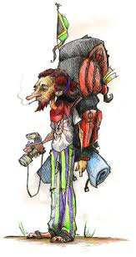
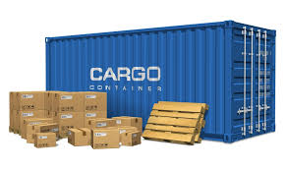
Two project examples
Cargo Centric
Intelligence services
Intelligent context aware devices
Mass data
Large scale reasoning
Dynamic criteria function
Novel business models
Incentive models
Cargo Centric

Slide 20
EURIDICE FP7 IP

Slide 21
Intelligent cargo

Slide 22
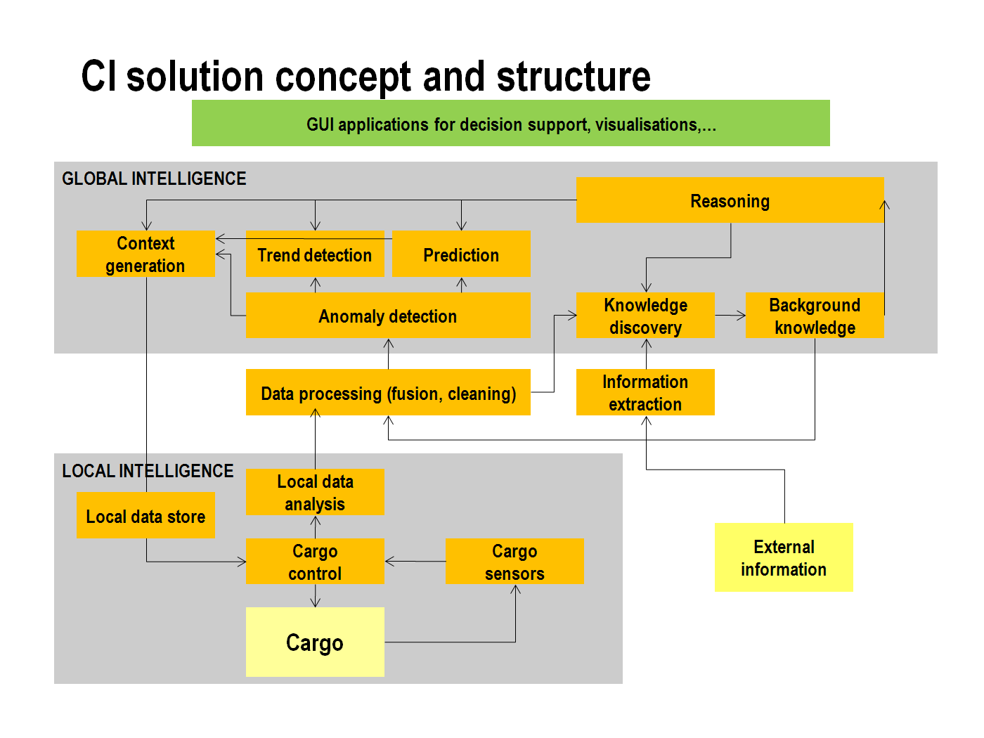

Slide 23
EURIDICE Context Model (ECM)
ECM - data and knowledge structure allowing access to cargo-related information (and services) from different domains and actors involved in Intelligent Cargo applications.
ECM Layers: Physical Layer (including core entities), Organizational Layer, Operational Layer, Regulatory Layer.
ECM Domains: Cargo Domain, Environment Domain, Transport Domain.
Figure 1: Structure of the EURIDICE context model

Slide 24
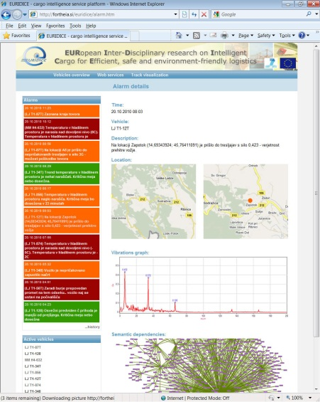
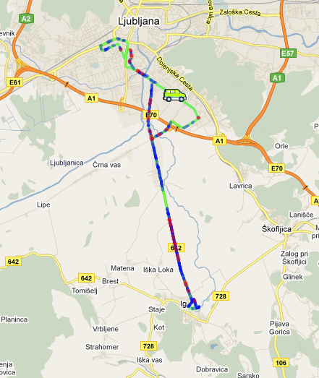
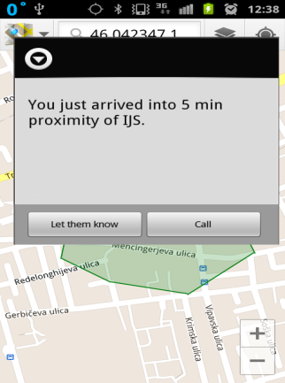
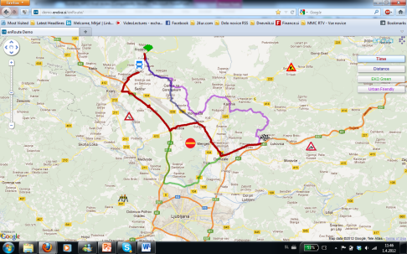
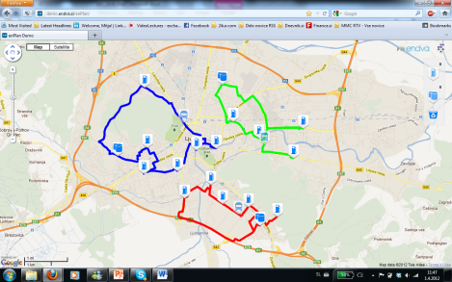
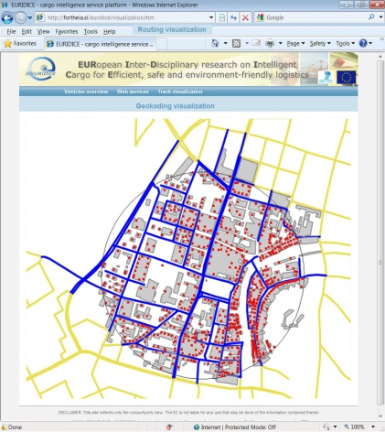
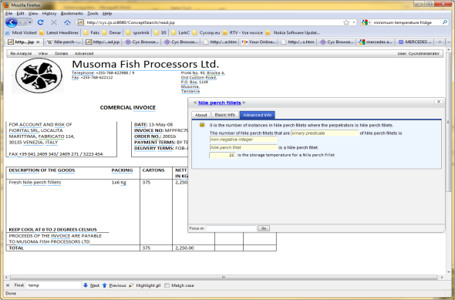
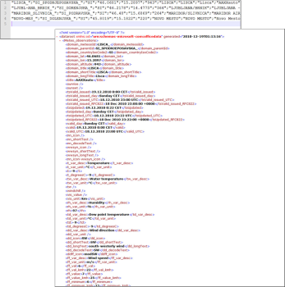
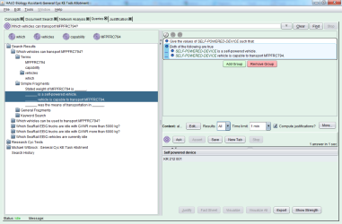
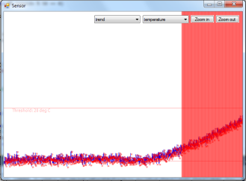
Intelligent freight transport
Monitoring, predicting and planning freight transport
Intelligent cargo, hitchhiking cargo
Prototype services
Predicting and planning efficient routes for distribution
Monitoring goods status
Freight Transport Optimisation

Slide 25
MobiS FP7 STREP - PERSONAL MOBILITY COMPANION
Personalized
MobiS Applications
Multi-Criteria
Planner
Service
Broker
Personal
Advisor
MobiS Knowledge
MobiS Information
Processing
(Decision Support)
Data Processing
Routing
Event Processing etc.
Service Offers
Ticketing
Clearing etc.
Crowd
Learning
“Federation”

Traffic
POI
Social
Media
Environment
Available
Information
Types
Events & News
Personal Data
Other

Slide 26
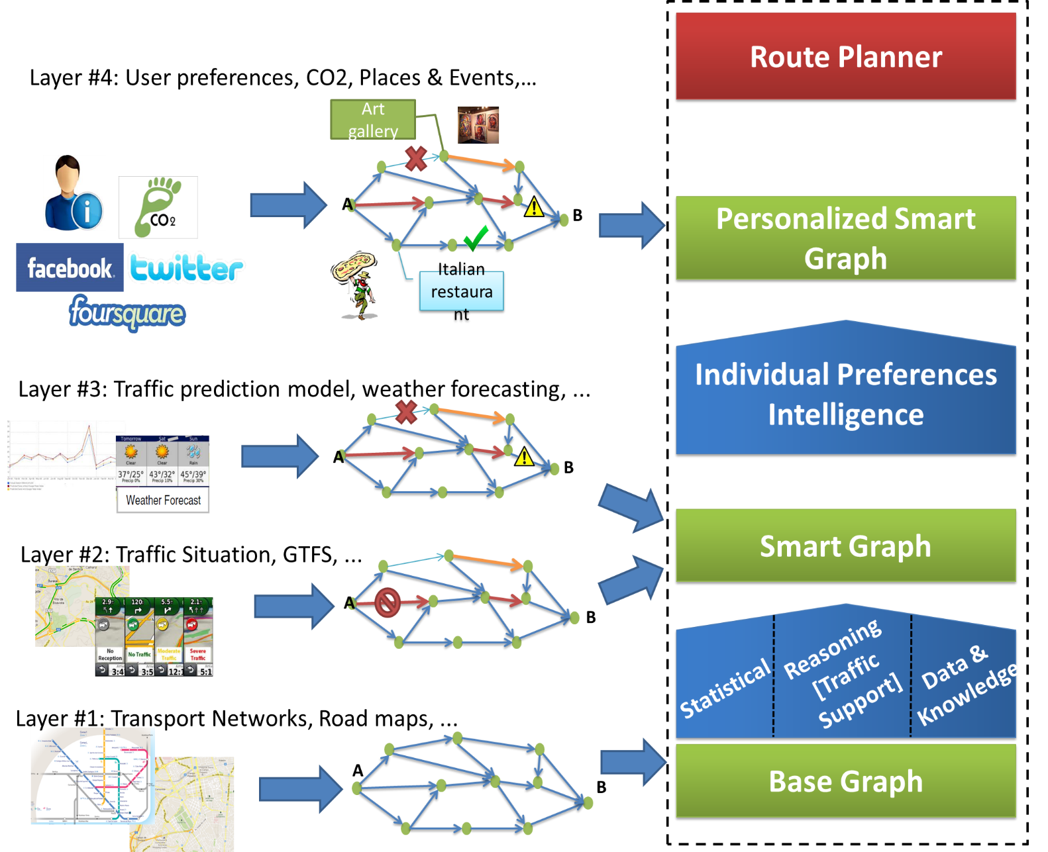
MobiS solution

Slide 27
Some of the Lessons Learned
Solutions in transportation use are still very traditional – lots of space for improvement
Some smartness present, the intelligence almost not there
  Why do we need CI? We handle stupid and not intelligent cargo.
Strong competition between logistic operators limits collaboration and any attempt towards synchronization
Existing business models are traditional – new value chains are still far away
Hard to get useful data from pilot users
There is no single incentive model for user to start using a transportation app

Slide 28
Some of the challenges and future directions

Slide 29
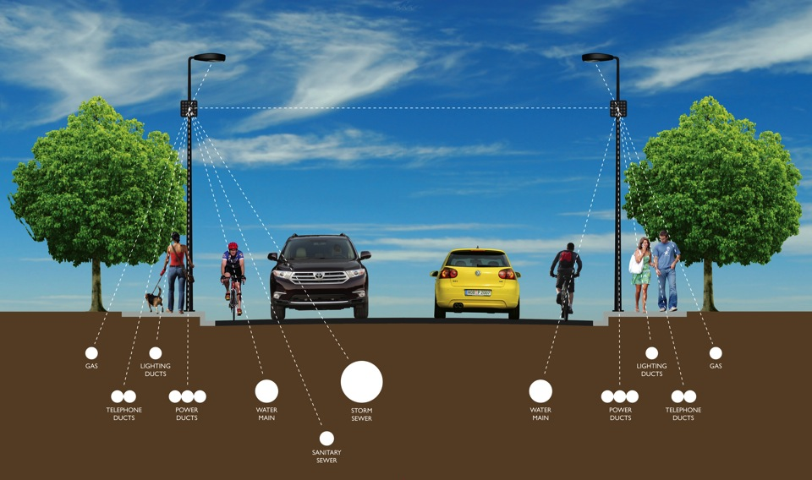
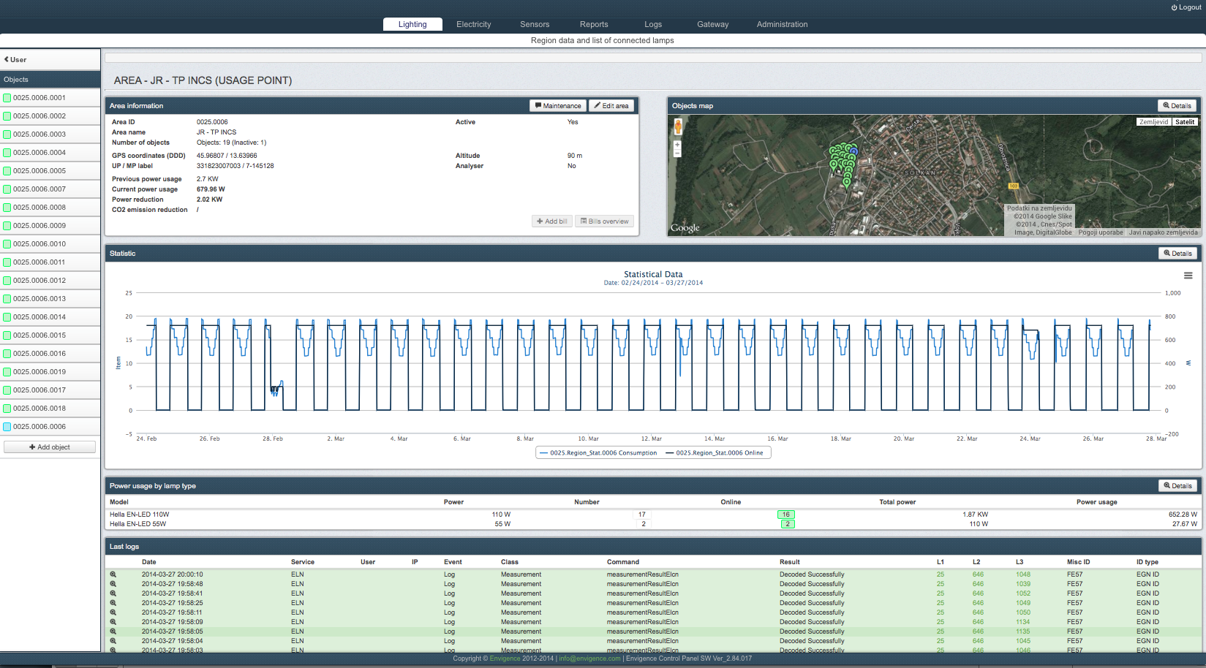
Smart city infrastructure
Notes:
Main focus areas:
Communication/sensors/actuators technology
Infrastructure optimization
Smart Community development

Slide 30
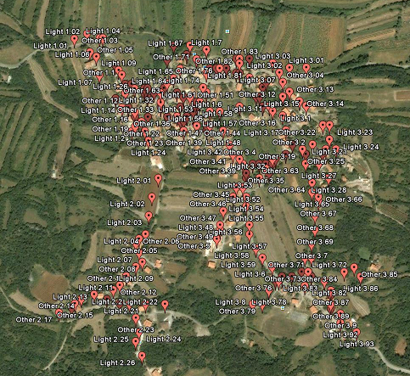


Two testbeds
The city of Logatec
Miren Kostanjevica Municipality

Slide 31

VESNA - Versatile Sensor Node
VESNA
  A modular sensor network platform
  VESNA node = SNC + SNR + SNE
  SNE-AMIO
    Supply 12 VDC
    Dimmers
      DIM1, DIM2, DIM3
    Digital inputs
      DI1, DI2, DI3, DI4, DI5, DI6, DI7, DI8
    Digital outputs
      DO1, DO2, DO3, DO4, (DO5), (DO6), (DO7), (DO8)
    Relays
      REL1, REL2, REL3, REL4
    Analog inputs
      AI1, AI2, AI3, AI4, AI5, AI6, AI7, AI8, AI9, AI10, AI11, AI12, AI13, AI14, AI15, AI16

Slide 32


Web-scale Reasoning: LarKC EU Project
Identify
Relevant Sources
Relevant Content
Select
Relevant Problems
Reason
Rule-based
Classification
Decide
Inconsistent reasoning
Enough answers?
Enough certainty?
Transform
Extract Information
Enough effort/cost?
Relevant Context
Calculate Statistics
Transform to Logic
Relevant Methods
Relevant Data
Decider
Identifier
Info Set Transformer
Identifier
Query
Transformer
Identifier
Info Set Transformer
Selecter
Reasoner
Data Layer
Data Layer
Data Layer
Data Layer
Plug-in API
Workflow
Support
System
Plug-in Registry
Decider
RDF
Store
Plug-in Manager
Plug-in Manager
Plug-in Manager
Plug-in Manager
Plug-in Manager
Plug-in API
Plug-in API
Plug-in API
Plug-in API
Plug-in API
Query
Transformer
Identifier
Info. Set
Transformer
Selecter
Reasoner
Notes:
LarKC workflows are more like work flows,
Data transfer can be virtualised

Slide 33
Urban computing
Monitoring crowd movement and predicting traffic in the cities
Installed in Seoul and Milano (pilot)
Baseline for urban planning and decision support
Urban plan optimization and security planning

Slide 34


Traffic Understanding
QUESTION: Image depicts Person?
ANSWER: PEDESTRIAN2A000282 is a person.
QUESTION: Image depicts UtilityPole?
ANSWER: UNCLASSIFIED0A000282 is a utility pole. POLE4A000282 is a utility pole. UNCLASSIFIED6A000282 is a utility pole. UNCLASSIFIED7A000282 is a utility pole. UNCLASSIFIED8A000282 is a utility pole. UNCLASSIFIED9A000282 is a utility pole. UNCLASSIFIED10A000282 is a utility pole.
QUESTION: Image depicts Automobile?
ANSWER: UNCLASSIFIED3A000282 is a car.
QUESTION: Image depicts Person?
ANSWER: PEDESTRIAN2A000283 is a person.
QUESTION: Image depicts UtilityPole?
ANSWER: UNCLASSIFIED0A000283 is a utility pole. POLE4A000283 is a utility pole. UNCLASSIFIED6A000283 is a utility pole. UNCLASSIFIED7A000283 is a utility pole. UNCLASSIFIED8A000283 is a utility pole. POLE9A000283 is a utility pole.
QUESTION: Image depicts Automobile?
ANSWER: UNCLASSIFIED3A000282 is a car.
Notes:
Figure 1 illustrates the user interface for sensor search and the results for the keywords “water level”. The grey circle indicates the area of interest and the orange flags represent sensor platforms (letters are illustrating the ranking). It can be observed that the results are relevant to the keyword and also the platforms with higher scores are in the area of interest.

Slide 35





Intelligent autonomous vehicle
Manage the complexity
of a mobile home
from a single mobile
device
Van transport sensors
(diagnostic, GPS, door, parking, gas …)
Van living space sensors
(water, gas, electricity, temperature, luminance, air quality …)
Local environment & social sensors
(weather, events, Twitter …)
Social network among camper cars

Slide 36

Prototype
Contextual intelligence system components
  Sensors
  Actuators
  Mobile app
  Rules engine
  Prediction
  User profiling

Slide 37
Intelligence pipeline
Alerting
Sensing
Managing
Forecasting

Slide 38

Symbiotic transportation
Symbiosis between man and machine
Symbioses of Transport, Environment, Society and Information

Slide 39
CYC KNOWLEDGE BASE (EXAMPLE)
  The typical bird has 1 beak, 1 heart, lots of feathers,…
  Hearts are internal organs; feathers are external protrusions
  Most vehicles are steered by an awake, sane, adult,… human
  Tangible objects can’t be in 2 (disjoint) places at once
  Badly injuring a child is much worse than killing a dog
  Causes temporally precede (i.e., start before) their effects
  A stabbing requires 2 cotemporal and proximate actors
  etc…

Slide 40






Why use Cyc? – Logistic domain

Slide 41

Cyc System Architecture

Slide 42

WHAT IS BEHIND (CYC)
1984
today
learning via
natural language
learning by discovery
codify & enter each piece of knowledge, by hand
rate of learning
CYC
CC
amount known
1000 person-years
29 real time years
~$98 million
Frontier of human knowledge
(Based on the slide by Doug Lenat)
Notes:
It can be dressed as assistant
Study companion

Slide 43

How we do it - Crowdlearning
RULE
ENGINE
API
KA Rules +
KA Forms
User ID,
Context
Legend:
Answer/Question
Initialization
Question/Answer
KA loop

Slide 44
Large scale information processing
http://eventregistry.org

Slide 45
Further Information
http://videolectures.net
http://ailab.ijs.si, http://sensorlab.ijs.si/
http://qminer.ijs.si
http://eventregistry.org. http://enrycher.ijs.si, http://newsfeed.ijs.si
http://www.cyc.com, Curious Cat on GooglePlay
http://www.transport-research.info/web/
mitja.jermol@ijs.si, dunja.mladenic@ijs.si, marko.grobelnik@ijs.si

Slide 47

Example: Twitter search “beer”
drinking, day, tonight, time, good, night, lol, mate, lovely, haha, christmas, work, home, ll, nice, yeah, food, back, today, feel, curry, wine, football, pint, opener, watch
beer, perfect, cheers, yolo, merrychristmas, fb, christmas, photo, camrgb, bliss, coyi, decent, lad, nightclubfails, coyg, superbowl, suffolk, buzzing, curry, vodka, becauseican, hangoverinthemorning

Slide 48

Example: Twitter search “hangover”
cure, day, feeling, drink, night, good, work, year, today, morning, haha, worst, love, tomorrow, time, christmas, bad, wake, food, bed, drunk
hangover, winning, happynewyear, perfect, food, nye, notfair, toooldforthisshit, dedication, sick, fucked, badtimes, backtobed, goodnight, yay, ouch, beer, fresh, dying, bed, death

